Slide 1
Rust
Designed for Safety
Carol (Nichols || Goulding)
@carols10cents

Slide 2
How does Rust prevent bugs?
What kinds of bugs are still possible?
Case studies: Would Rust have prevented these problems?

Slide 3
What is Rust?
Started in 2009
Sponsored by Mozilla
Systems language, aiming to replace C and C++
Fast, concurrent, and safe
Notes:
One slide of background

Slide 4
How does Rust prevent bugs?

Slide 5
How does Rust prevent bugs?
Immutable by default
Array bounds checks
Ownership
Strongly typed
Warnings
`match` must handle all cases
Not allowed to use a variable before initializing
No nullable pointers
No undefined behavior

Slide 6
Immutable by default
let x = 5;
x += 10;

Slide 7
Immutable by default
let x = 5;
x += 10;
^ error: re-assignment of
immutable variable `x`

Slide 8
Immutable by default
let mut x = 5;
x += 10;
Notes:
Explicit about what might change
Errors if code tries to change something you thought shouldn’t change.

Slide 9
Array Bounds Checking
let buffer = [10, 20, 30];
println!("{}", buffer[100]);

Slide 10
Array Bounds Checking
let buffer = [10, 20, 30];
println!("{}", buffer[100]);
thread '<main>' panicked at
'index out of bounds: the len
is 3 but the index is 100'

Slide 11
Ownership

Slide 12
Ownership
Memory has one and only one owning scope
That scope is responsible for freeing the memory

Slide 13
Shared Mutable State
Use after free
Double free
Data Races

Slide 14
Lexical scoping
fn main() {
let x = Thing::new();
if x.floopy() {
let y = OtherThing::new(x.florp());
println!(“y is {}”, y);
}
}
Notes:
What about calling functions with arguments

Slide 15
Move by default

Slide 16
fn main() {
let x = Thing::new();
whatevs(x);
println!(“x is {}”, x);
}
fn whatevs(t: Thing) {
println!(“I just want to print {}”, t);
}

Slide 17
fn main() {
let x = Thing::new();
whatevs(x);
println!(“x is {}”, x);
}
fn whatevs(t: Thing) {
println!(“I just want to print {}”, t);
}
^ error: use of moved
value: `x`

Slide 18
Borrowing

Slide 19
fn main() {
let x = Thing::new();
whatevs(&x);
println!(“x is {}”, x); // cool.
}
fn whatevs(t: &Thing) {
println!(“I just want to print {}”, t);
}
Notes:
Difference: ampersand at caller and callee indicates borrow
whatevs returns thing, does not clean it up
main is still the owner and does clean up

Slide 20
fn whatevs(t: &Thing) {
t.price += 50;
}
Notes:
Borrows are immutable by default too. If instead of printing, we want to change thing

Slide 21
fn whatevs(t: &Thing) {
t.price += 50;
}
^ error: cannot assign to
immutable field `t.price`

Slide 22
fn whatevs(t: &mut Thing) {
t.price += 50;
}

Slide 23
fn main() {
let mut x = Thing::new();
whatevs(&mut x);
println!(“x is {}”, x);
}
fn whatevs(t: &mut Thing) {
t.price += 50;
}

Slide 24
Borrowing Rules
Many immutable borrows
Only one mutable borrow (and no immutable borrows)

Slide 25
let mut list = vec![1, 2, 3];
for i in &list {
println!(“i is {}”, i);
list.push(i + 1);
}
Notes:
What is this code doing?

Slide 26
let mut list = vec![1, 2, 3];
for i in &list {
println!(“i is {}”, i);
list.push(i + 1);
}
^ error: cannot borrow `list`
as mutable because it is also
borrowed as immutable

Slide 27
These rules apply when using multiple threads too, and make concurrency safe.
(example left as an exercise for the reader)

Slide 28
BUT WAIT! THERE’S MORE!

Slide 29
At COMPILE time!*
*except for array bounds checks
Notes:
Why is this important?
what affects the cost of fixing a bug
what if these checks happened at runtime instead

Slide 30
What bugs are still possible?
Notes:
Is Rust a silver bullet?

Slide 31
unsafe

Slide 32
unsafe keyword lets you…
Dereference a raw pointer
Read or write a mutable static variable
Call an unsafe function
Notes:
Lets you opt out of the compiler’s checks. A way to say “I, the human, have checked this code and found it to uphold the restrictions of safety, so you, the compiler, should let me run whatever is in here”

Slide 33
Rust does not prevent…
Integer overflows
Deadlocks
Non-data race conditions
Leaking memory
Failing to call destructors
Crashing the program
Notes:
What’s a big kind of bug that is still possible in Rust?
Hint: Would you still need to test Rust code?

Slide 34
Logic errors
Notes:
A compiler is never going to be able to check that you’re doing the thing that you want to be doing.

Slide 35
Case Studies

Slide 36


Slide 37
Heartbleed
April 2014

Slide 38
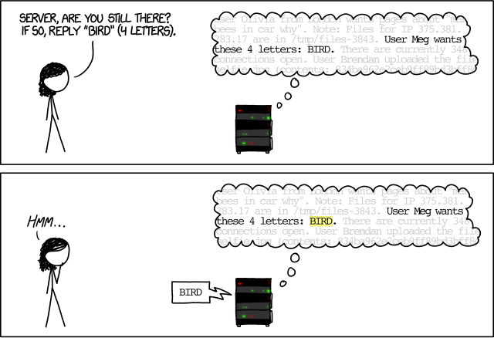

Slide 39
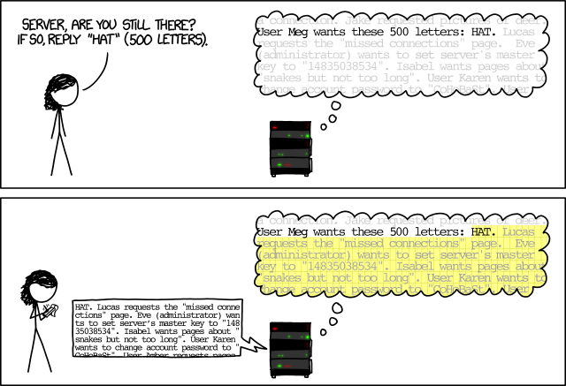

Slide 40
Root causes

Slide 41
Root causes
Buffer overread
Did not validate user input
Reusing a buffer
Wrote their own memory allocator
Notes:
Not idiomatic C

Slide 42
Rust would help prevent this because…
No out of bound memory reads
Less convenient to share memory

Slide 43
Would Rust have prevented Heartbleed?

Slide 44
Would Rust have prevented Heartbleed?
Maybe.
Notes:
You can write crappy code in any language.

Slide 45
Would Rust have prevented Heartbleed?
Bad Rust < Bad C?
Notes:
Does Rust make it less likely that you’ll write bad code?

Slide 46
Apple `goto fail`
Feb 2014
Notes:
Verifying a signature of a handshake for a secure connection

Slide 47
if ((err = ReadyHash(&SSLHashSHA1, &hashCtx)) != 0)
goto fail;
if ((err = SSLHashSHA1.update(&hashCtx, &clientRandom)) != 0)
goto fail;
if ((err = SSLHashSHA1.update(&hashCtx, &serverRandom)) != 0)
goto fail;
if ((err = SSLHashSHA1.update(&hashCtx, &signedParams)) != 0)
goto fail;
goto fail;
if ((err = SSLHashSHA1.final(&hashCtx, &hashOut)) != 0)
goto fail;
Notes:
If something isn’t right, we need to set `err` and THEN goto fail.
Skipping some of these checks means invalid things might get through WITHOUT getting the value in `err` that they should have, and will look like success.
bad alignment
no curly braces
`goto` makes it hard to follow code
dead code

Slide 48
Rust would help prevent this because…
Required braces around `if` bodies
Dead code warnings on by default
No `goto` statement

Slide 49
fn verify(certificate: &mut Certificate) {
if certificate.valid_until() > Date::today() {
certificate.valid = false;
return;
}
return;
if certificate.ready_hash(&SSL_HASH_SHA) {
certificate.valid = false;
return;
}
}

Slide 50
fn verify(certificate: &mut Certificate) {
if certificate.valid_until() > Date::today() {
certificate.valid = false;
return;
}
return;
if certificate.ready_hash(&SSL_HASH_SHA) {
^ warning: unreachable statement
certificate.valid = false;
return;
}
}

Slide 51
Would Rust have prevented `goto fail`?

Slide 52
Would Rust have prevented `goto fail`?
Probably.

Slide 53
the point?

Slide 54

Computers are good at tedium.
⚠️Beep, boop. You forgot a
semicolon in 23,982 places

Slide 55
Rust has the computer
handle more tedium,
so you can concentrate
on your real problem.
Notes:
Rust is not the only tool to do this - we NEED many different ways to make programming correctly easier
I want to keep seeing innovation like this
We don’t have to keep creating the same bugs over and over

Slide 56
Questions?

Slide 57
HOMEWORK

Slide 58
HOMEWORK
(just kidding)

Slide 59
is.gd/rust_safety

Slide 60
Want more Rust??

Slide 61
Rust coffee
Every Wednesday 6:30pm-8:30pm
Coffee Tree Roasters at Bakery Square
Work on Rust projects, talk with other people working on Rust projects

Slide 62
Rust Belt Rust Conference
Thurs Oct 27-Fri Oct 28, 2016
rust-belt-rust.com
@rustbeltrust

